Slide 1

Customer Shopping Behavior Analysis
Analyzing 3,900 customer transactions to uncover spending patterns, preferences, and strategic opportunities for business growth.

Slide 2
Dataset Overview
3,900
18
37
Total Purchases
Data Features
Missing Values
Transactions analyzed across all categories
Comprehensive customer and purchase attributes
Only in Review Rating column
Customer Demographics
Purchase Details
Age, Gender, Location
Item, Category, Amount
Subscription Status
Season, Size, Color
Discounts & Shipping Type

Slide 3

Data Preparation Journey
01
Data Loading & Exploration
Imported dataset using pandas and examined structure with df.info() and summary statistics.
02
Missing Data Handling
Imputed 37 missing Review Rating values using median rating per product category.
03
Feature Engineering
Created age_group and purchase_frequency_days columns for deeper analysis.
04
Database Integration
Connected to PostgreSQL and loaded cleaned data for SQL analysis.

Slide 4
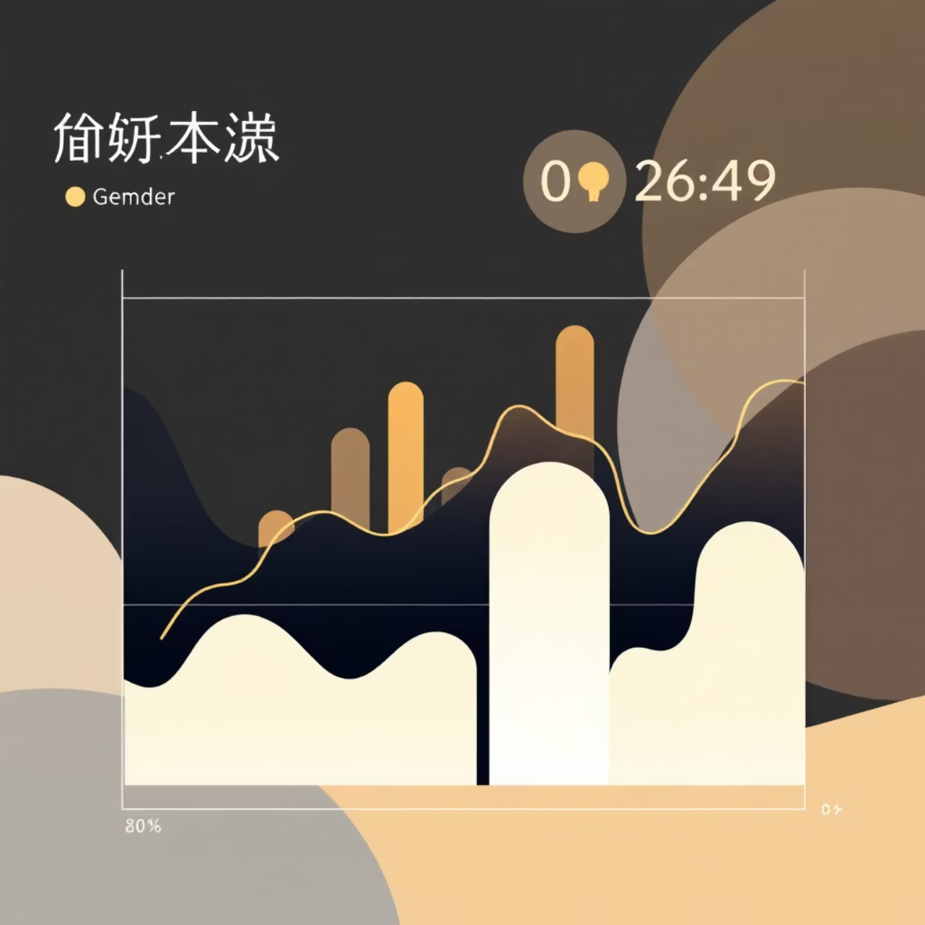
Revenue Insights by Gender
Analysis revealed spending patterns across male and female customers, providing insights into gender-based purchasing behavior and revenue contribution.
This segmentation helps tailor marketing strategies and product offerings to maximize engagement with each demographic group.

Slide 5

Customer Segmentation Strategy
New Customers
Returning Customers
Loyal Customers
First-time buyers exploring the product catalog and building initial brand experience.
Repeat purchasers showing interest and engagement with the brand.
High-frequency buyers with strong brand affinity and consistent purchase patterns.
Classification based on purchase history enables targeted retention and growth strategies for each segment.

Slide 6
Top-Rated Products Drive Success
Highest Rated Items
Category Leaders
Identified top 5 products with exceptional customer satisfaction scores.
Best-selling products within each category drive revenue and customer loyalty.
Products with high ratings and strong sales performance should be featured prominently in marketing campaigns to maximize conversion.

Slide 7



Subscription vs. Non-Subscription Analysis
Key Finding
Customers with more than 5 purchases show significantly higher subscription rates, indicating strong correlation between purchase frequency and subscription adoption.
Subscribers demonstrate higher average spend and contribute greater total revenue compared to non-subscribers.
68%
32%
Repeat buyers with subscriptions
Higher average spend by subscribers

Slide 8

Discount Strategy Insights
High-Spending Discount Users
Discount-Dependent Products
Identified customers using discounts while maintaining above-average purchase amounts, revealing opportunity for strategic promotions.
Five products show highest percentage of discounted purchases, requiring careful margin management.
Shipping Type Impact
Express shipping users show different average purchase amounts compared to standard shipping customers.

Slide 9
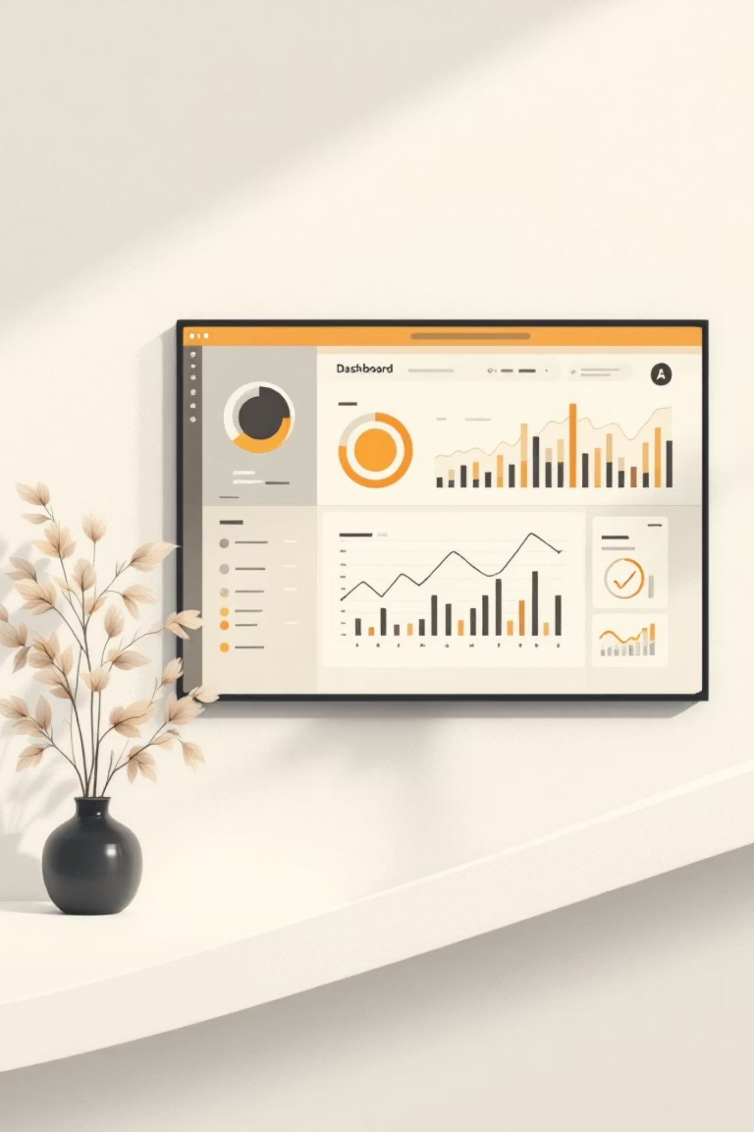

Interactive Power BI Dashboard
Comprehensive visual dashboard presenting all key insights including revenue trends, customer segments, product performance, and demographic analysis in an interactive format.
Real-Time Metrics
Dynamic Filtering
Actionable Insights

Slide 10

Strategic Recommendations
Boost Subscriptions
Promote exclusive benefits to convert high-frequency buyers into subscribers.
Customer Loyalty Programs
Reward repeat buyers to accelerate movement into the "Loyal" segment.
Review Discount Policy
Balance promotional sales boosts with margin control for sustainable growth.
Targeted Marketing
Focus campaigns on high-revenue age groups, top-rated products, and express-shipping users.

